Slide 1
Internship Final Review
Organization Name : Whirlpool Corporation (GTEC)
Domain : Data Analytics (Informatica Developer)
Name - Om Parag Butala
Class - CS-C-3 BTech
PRN - 22120149
Guide : Prof. Namrata Wasatkar
Industry Manager : Nitin Phuke
Industry Mentor : Mohit Shrivastava

Slide 2

Informatica PowerCenter

Slide 3
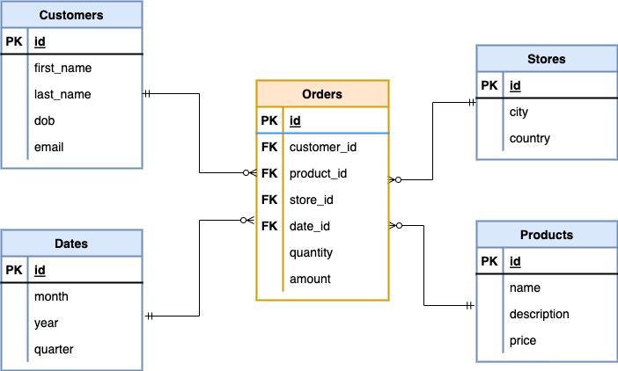
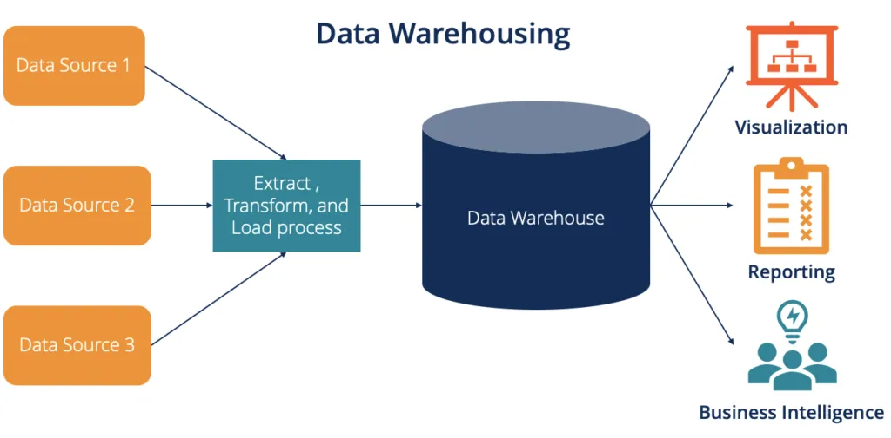
Data Warehousing
Fact and Dimension

Slide 4
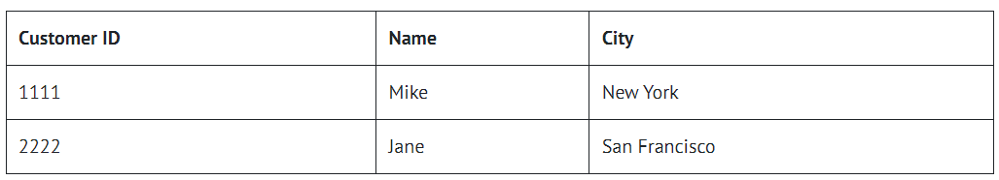
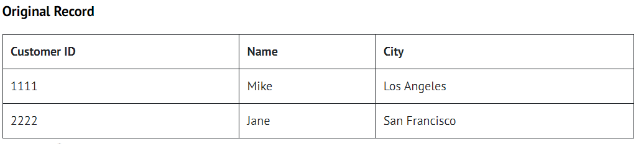
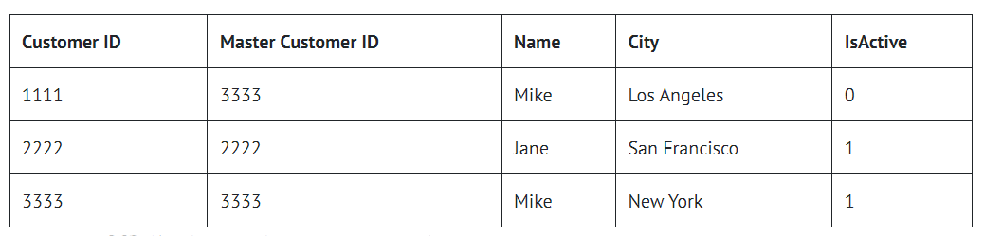
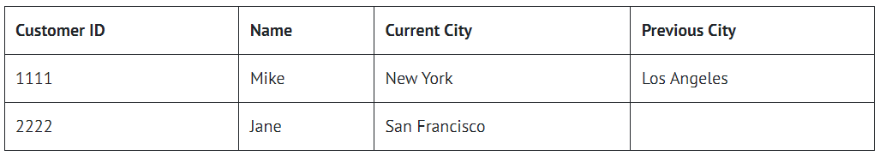
Slowly Changing Dimension (SCD):
Type 1 SCD – Update
Type 2 SCD – Insert
Type 3 SCD – Update + Insert

Slide 5
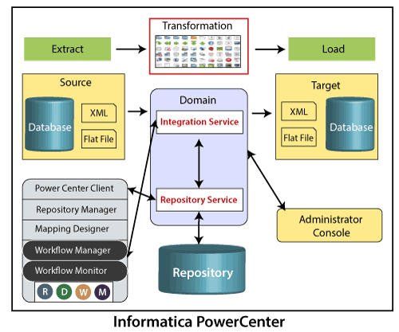
Informatica PowerCenter Architecture

Slide 6
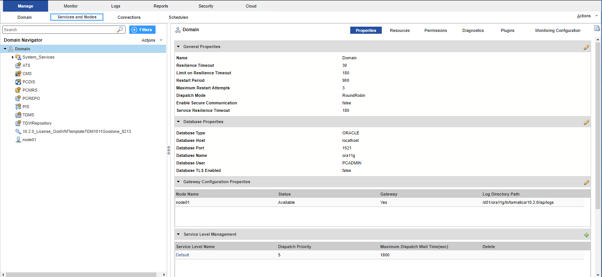
Informatica Administration
Folder Creation and Deletion from Repo Manager
User Creation
Group Creation
Child Group Creation
Assign Role and Permission to User and Group
Custom Role Creation

Slide 7
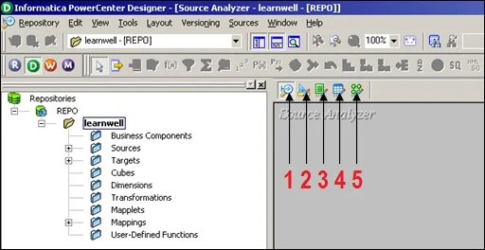
PowerCenter Designer
• Source Analyzer
• Target Designer
• Transformation Developer
• Mapplet Designer
• Mapping Designer

Slide 8
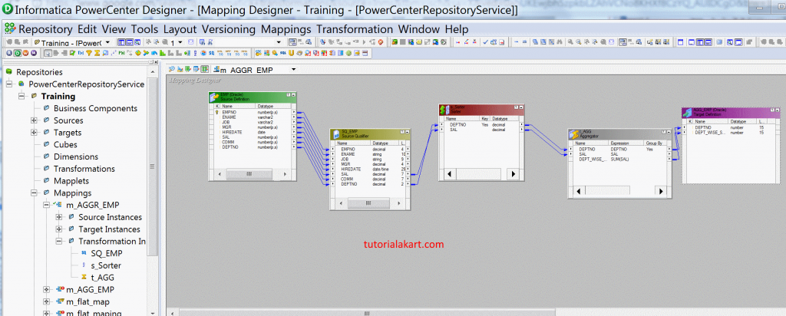
Lifeline of Informatica: Transformations
Active Transformation :
Source Qualifier
Aggregator
Filter
Joiner
Rank
Sorter
Router
Union
Update Strategy
Normalizer
Passive Transformation :
Expression
Lookup
Sequence generator

Slide 9
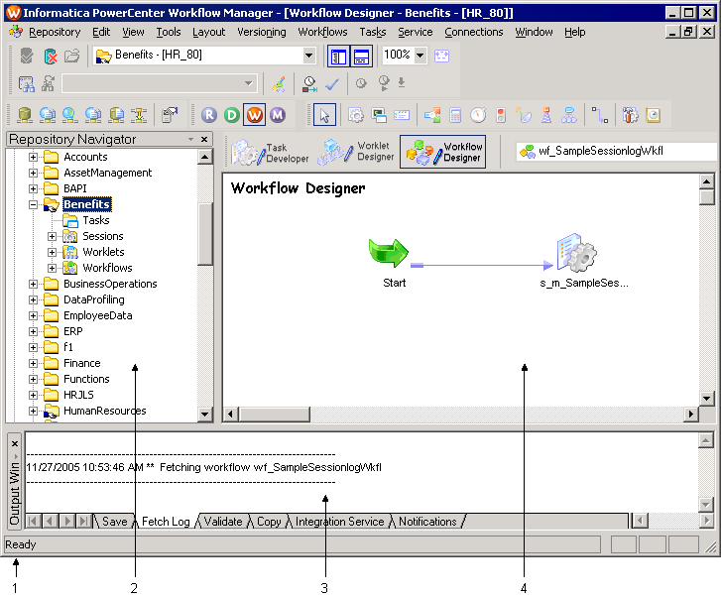
Workflow Manager:
Tasks
A Workflow in Informatica is a set of multiple tasks connected with start task link and triggers the proper sequence to execute a process.
When a workflow in Informatica is executed, it triggers a start task and other tasks connected in the workflow.

Slide 10
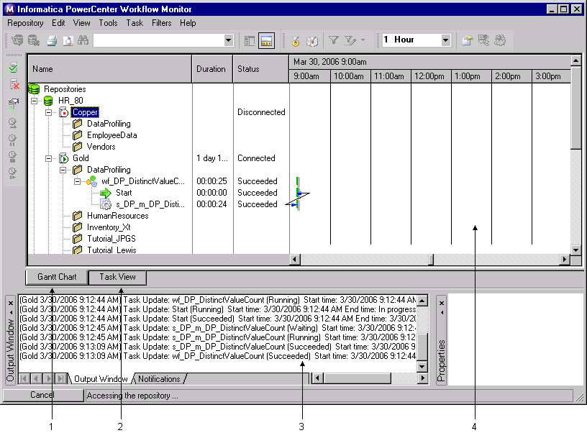
Workflow Monitor
Workflow monitor is a tool with the help of which you can monitor the execution of workflows and task assigned to the workflow.

Slide 11
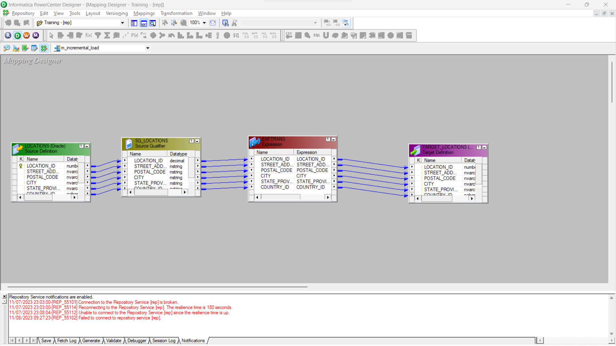
Incremental Data load

Slide 12
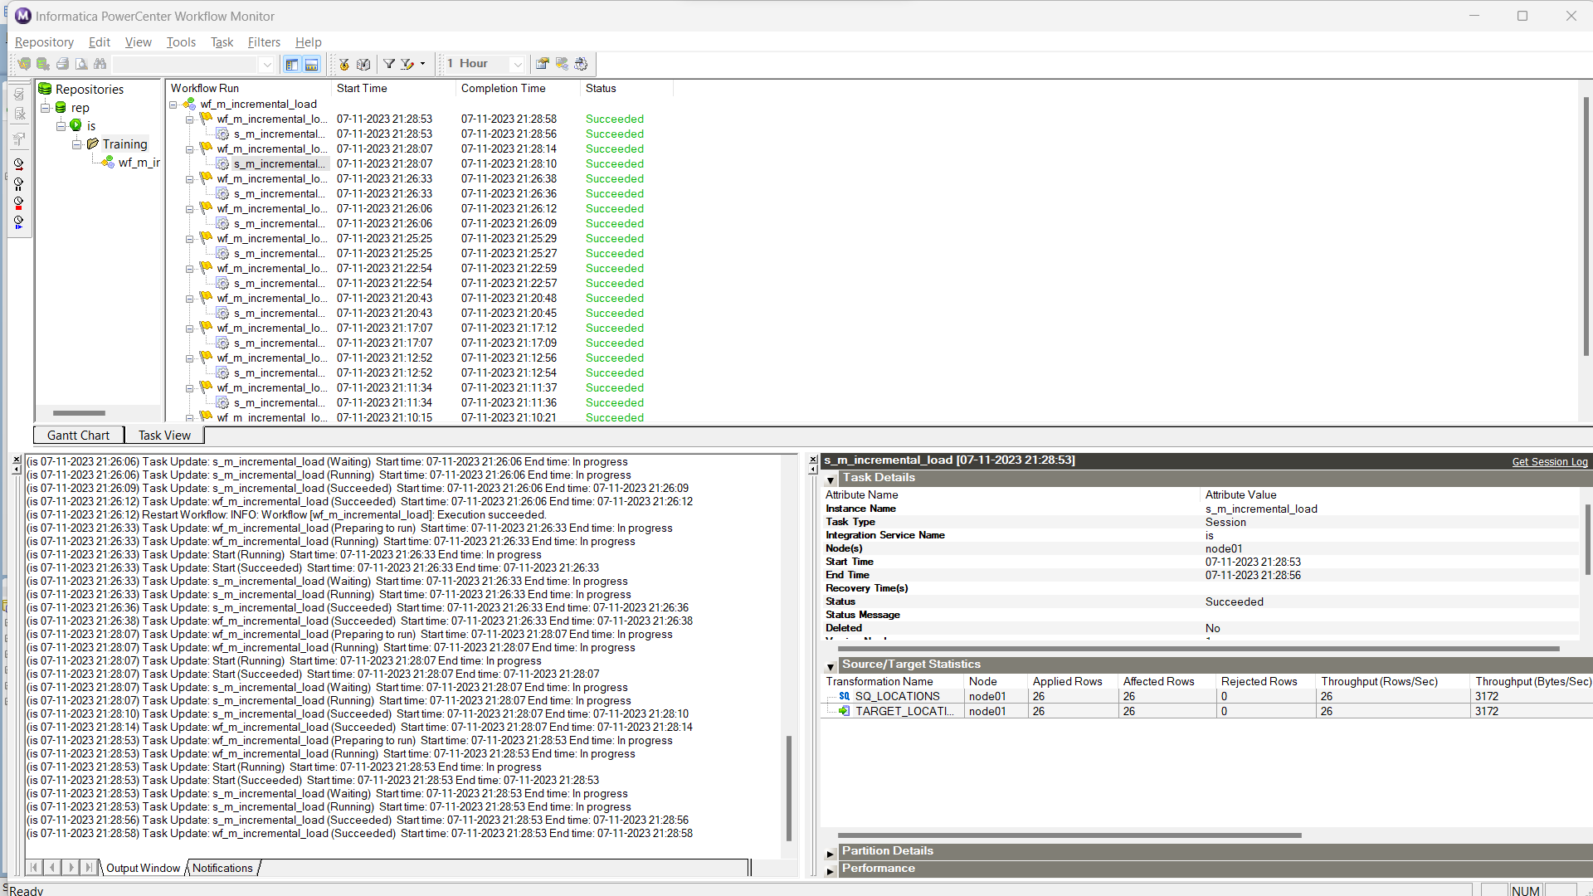

Slide 13
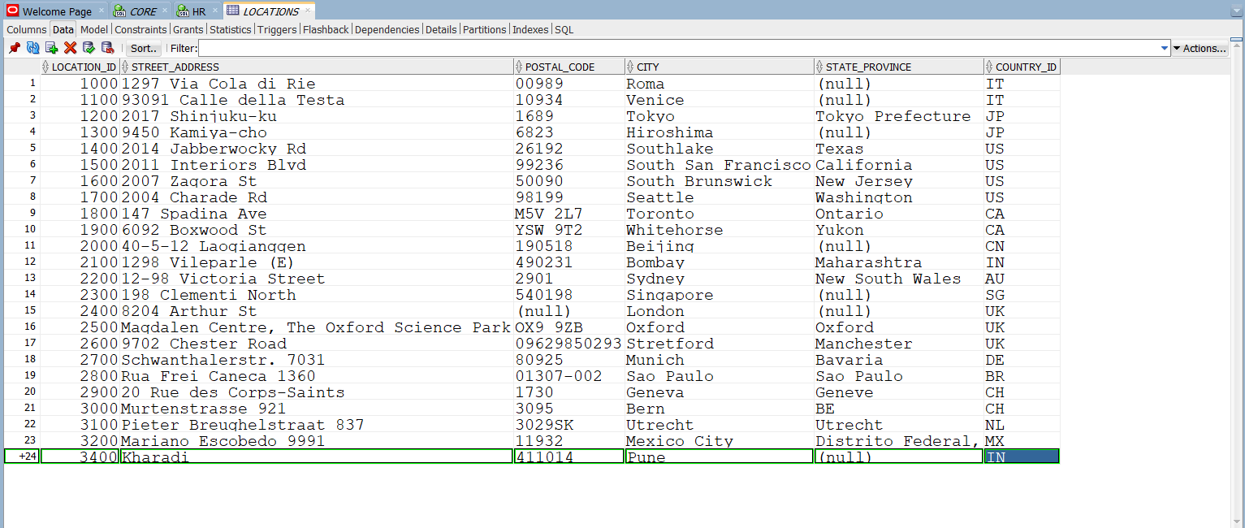

Slide 14
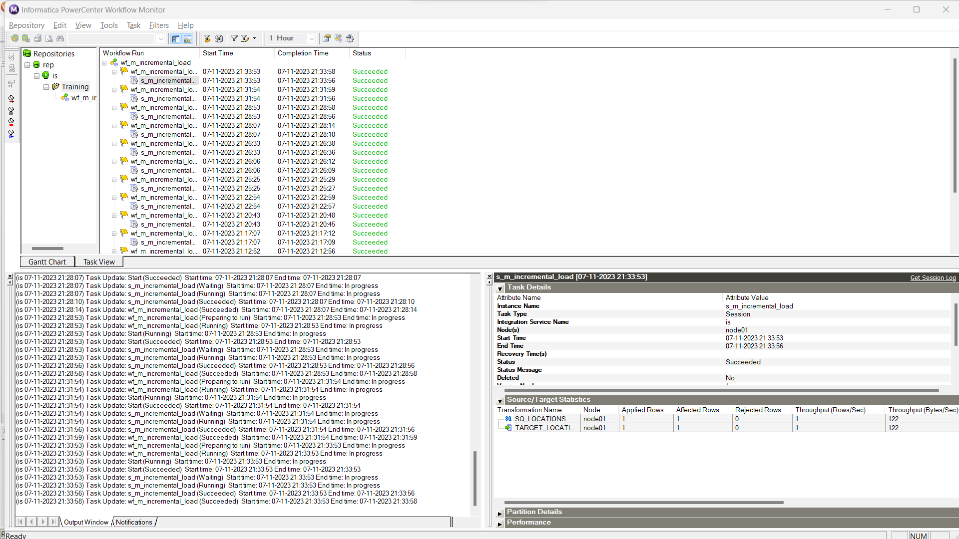

Slide 15
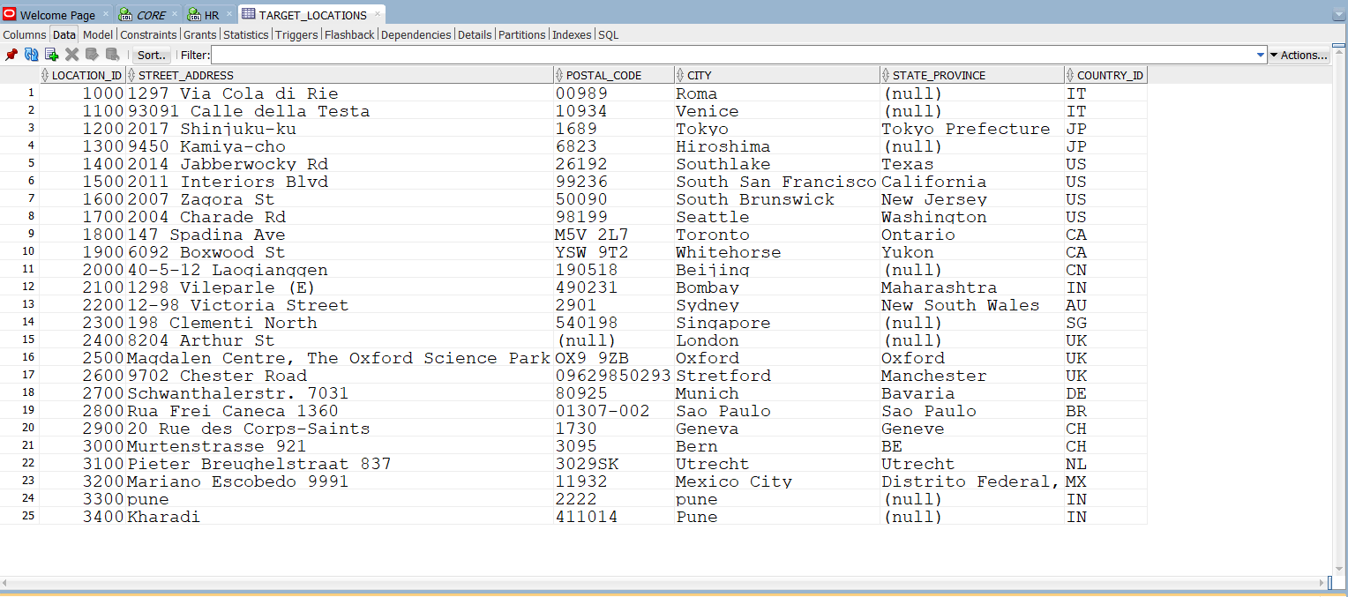

Slide 16
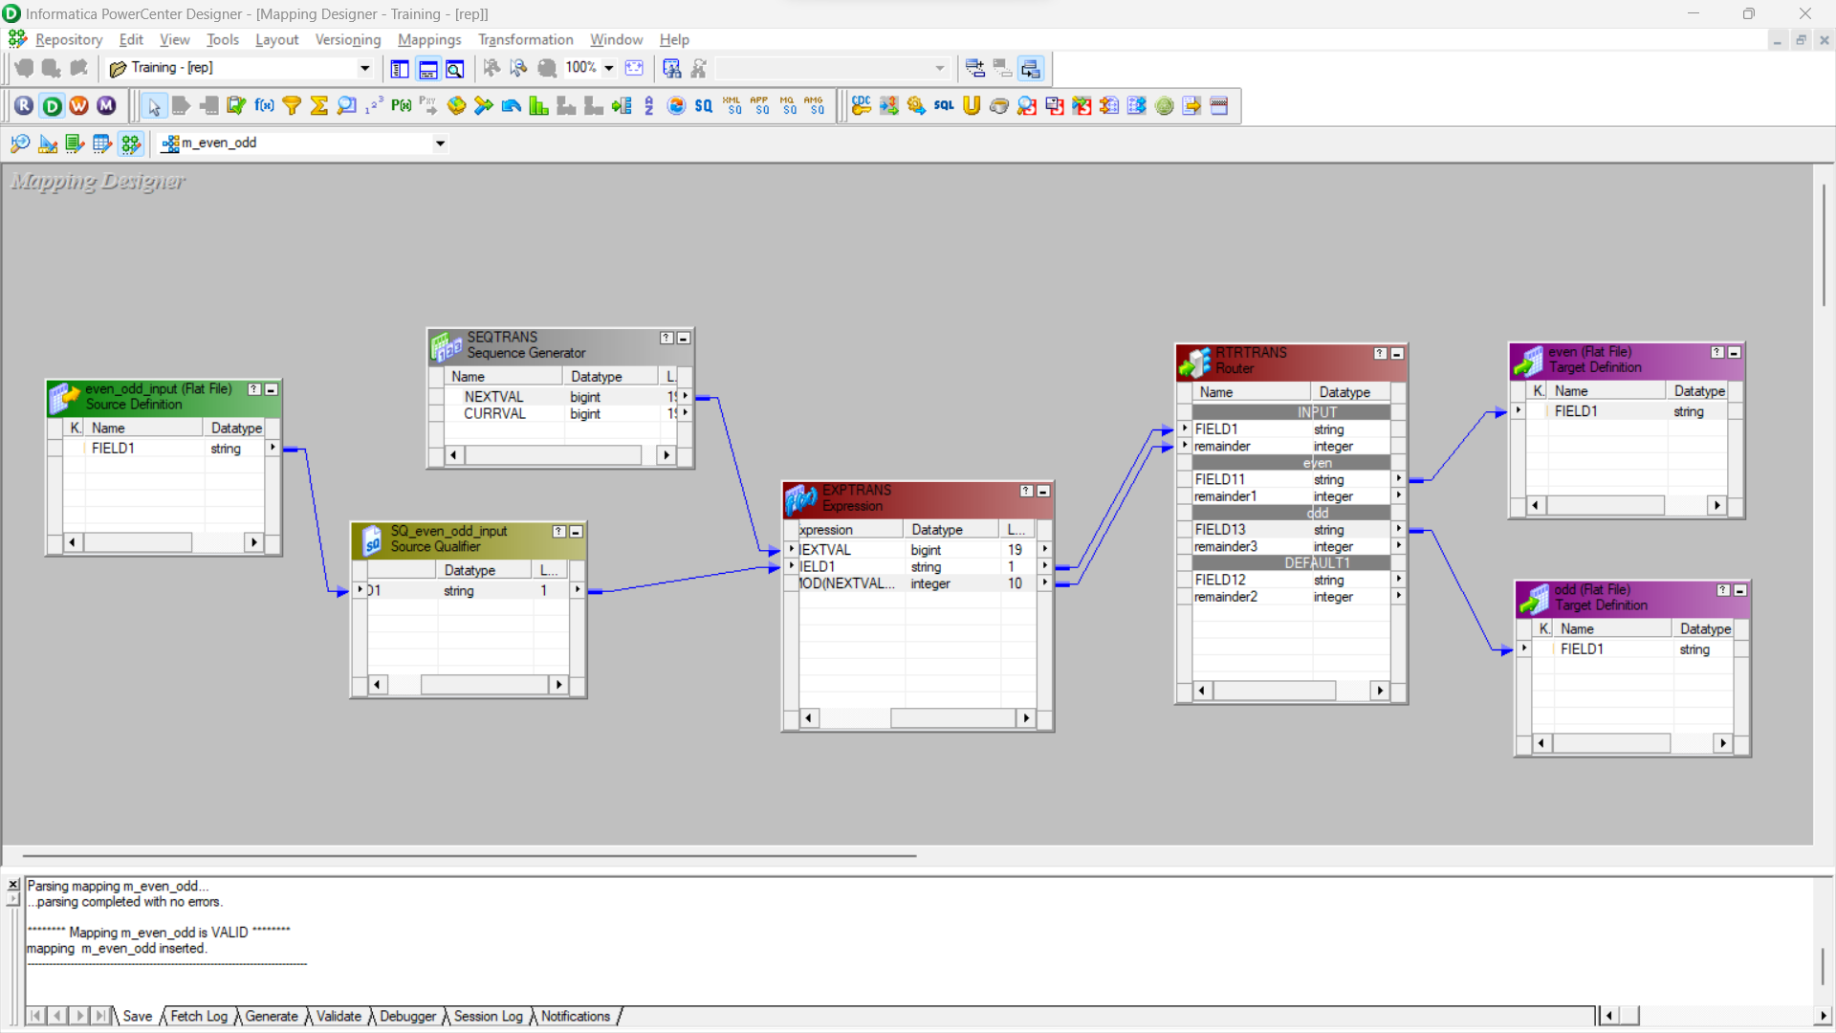
Send Alternate Data into two different targets(Even and Odd).

Slide 17
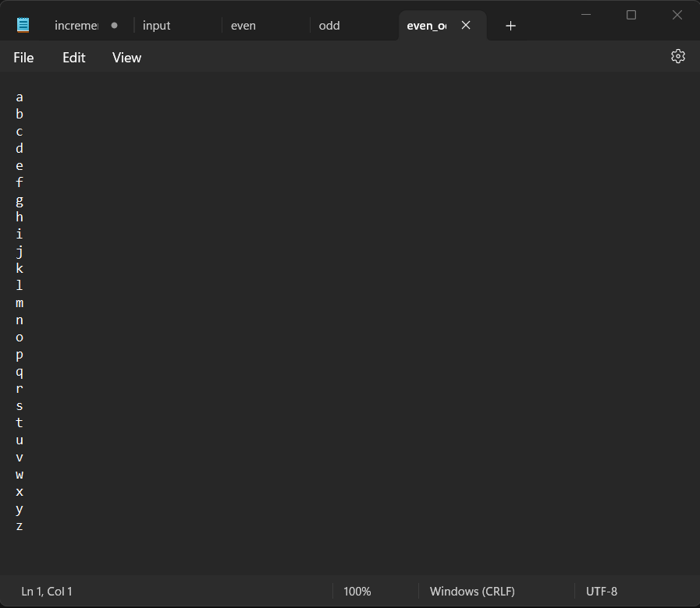

Slide 18
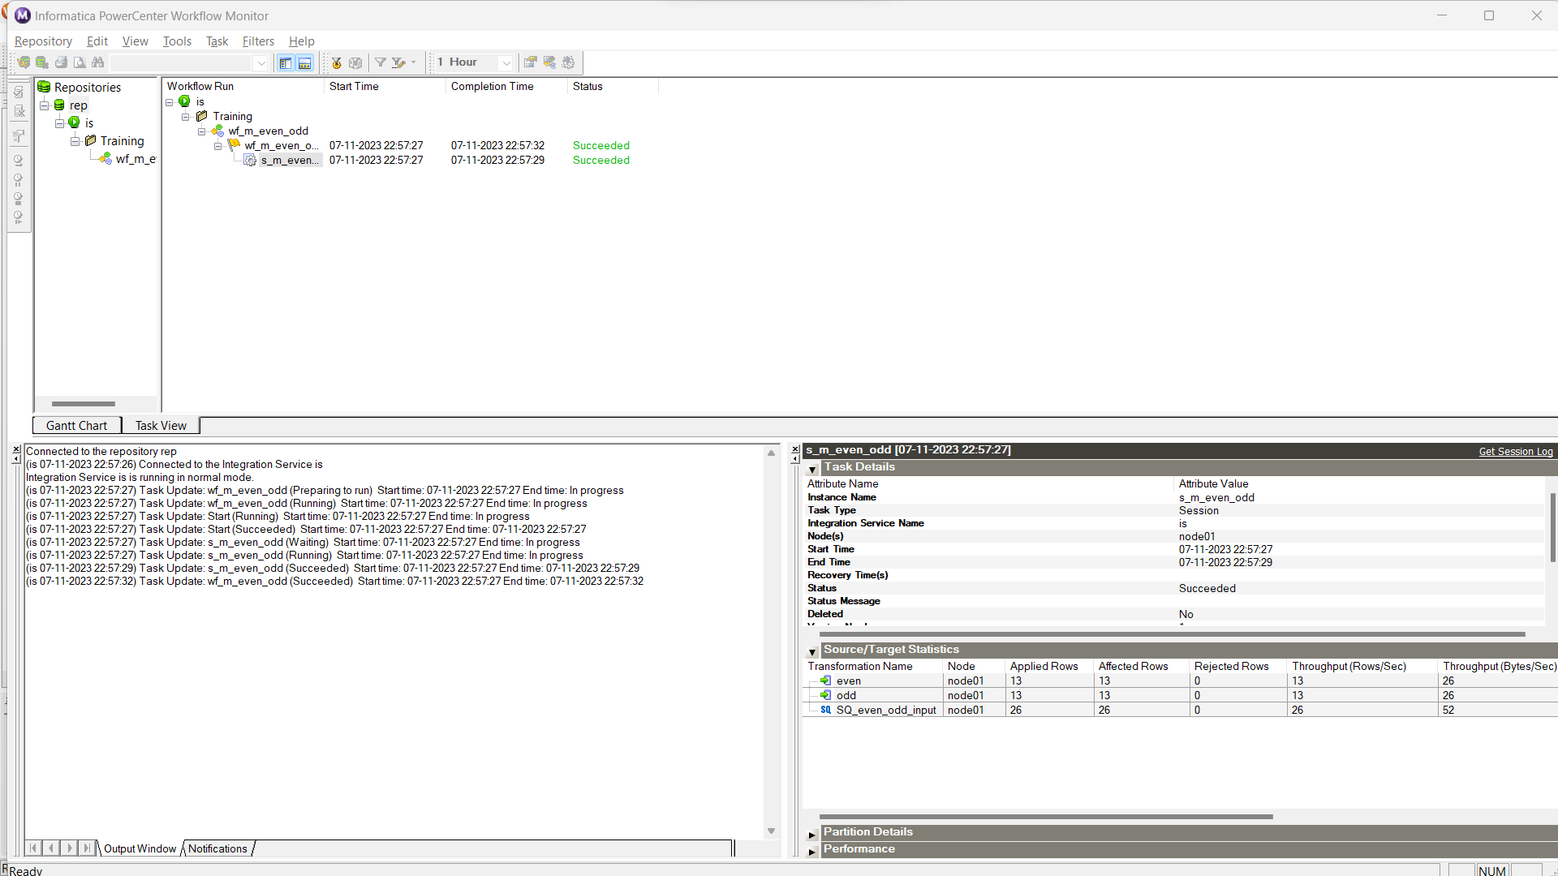

Slide 19
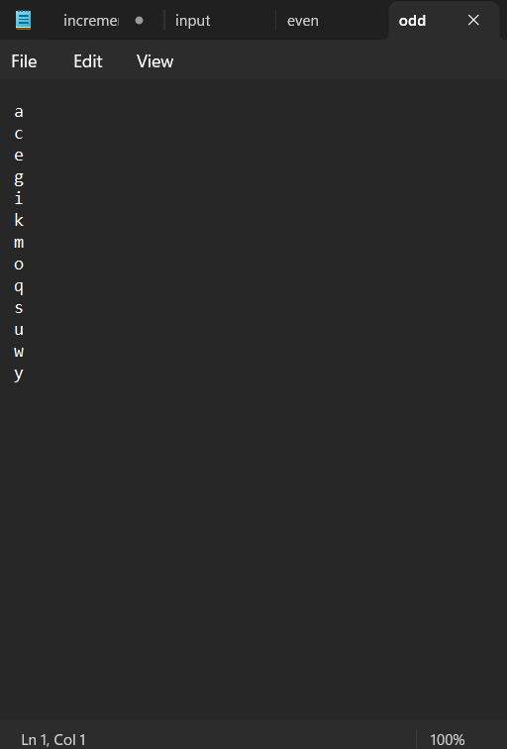
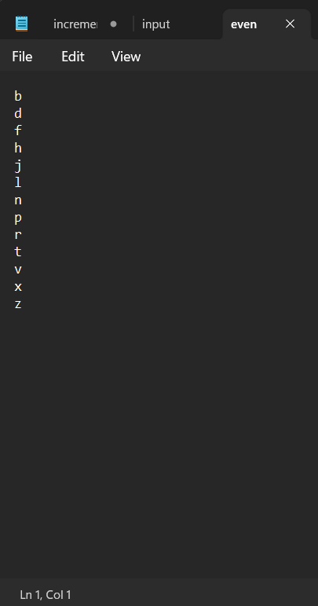
Output:

Slide 20


